Slide 1
Cloud Application
Cloud Computing: A Hands-On Approach by Arshdeep Bahga and Vijay Madisetti
www.cloudcomputingbook.info

Slide 2
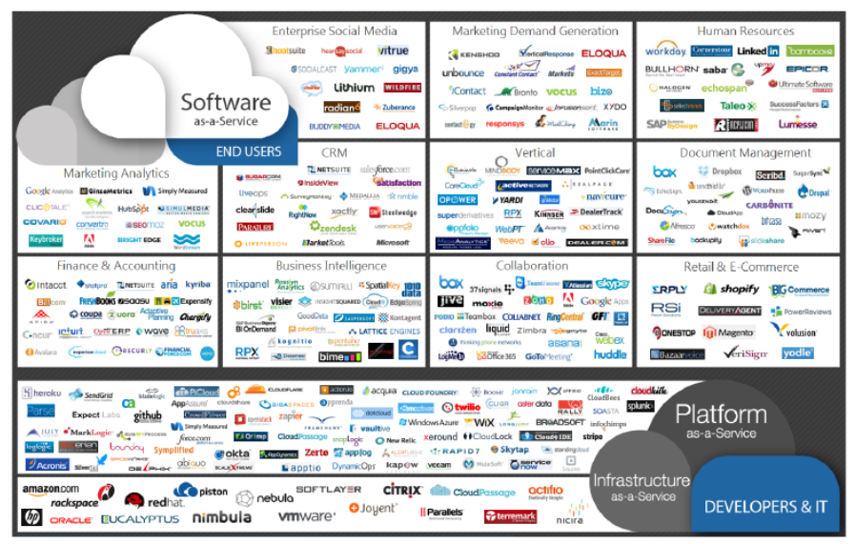
Source: Cloud Computing for Science and Engineering by Kan Foster and Dennis Gannon
Notes:
Web applications, mobile applications, and client-server applications have evolved significantly in the past decade and are now quite dynamic. These applications allow users to interact and collaborate, include user generated content such as comments and discussions, integrate social networks and multimodal content such as text, images, audio, video, presentations, etc., in various formats. Due to this dynamic nature of modern web applications, the traffic patterns for such applications are becoming more an more unpredictable. Traditional approaches that were based on the ‘one size fts all’ paradigm no longer work for modern applications. In this class, you will learn about the characteristics of cloud applications, the reference architectures for various types of applications and design methodologies such as SOA, CCM and MVC.

Slide 3
Outline
Characteristics of Cloud Applications
Reference Architectures of Cloud Applications
Design Methodologies
Data Storage
Data Analytics
Deployment & Management
http://www.numericana.com/answer/graphs.htm
Notes:
In this class, we will learn the basic concept and knowledge about cloud applications.

Slide 4
Characteristics of Cloud Applications
Scalability
Reliability & Availability
Security
Maintenance & Upgradation
Performance
Notes:
Scalability is an important factor that drives the application designers to move to cloud computing environments. Building applications that can serve millions of users without taking a hit on their performance has always been challenging. With the growth of cloud computing application designers can provision adequate resources to meet their workload levels.

Slide 5
Characteristics of Cloud Applications
Scalability
loose coupling of components
Asynchronous communication
Stateless design
Database choice and design
Notes:
Traditional approaches were based on either over-provisioning of resources to handle the peak workload levels expected or provisioning based on average workload levels can lead to traffic overloads, slow response times, low throughputs and hence loss of opportunity to serve the customers. In order to leverage the benefits of cloud computing such as dynamic scaling, we can use the following design considerations for cloud applications.
We can scale each component independently by designing loosely coupled components.
By allowing asynchronous communication between components, we can add capacity by adding additional servers when the application load increases.
Stateless designs that store state outside of the components in a separate database allow scaling the application components independently.
Choice of the database and the design of data storage schemes affect the application scalability. Choose a traditional relational database (SQL approach) with strict schemas or a schema-less database (No-SQL approach) should be made after careful analysis of the application’s data storage and analysis requirements.

Slide 6
Characteristics of Cloud Applications
Reliability & Availability
No single point of failure
Trigger automated actions on failures
Graceful degradation
Logging
Replication
Notes:
Reliability of a system is defined as the probability that a system will perform the intended functions under stated conditions for a specified amount of time. Availability is the probability that a system will perform a specified function under given conditions at a prescribed time.
To high achieve reliability and availability, having a redundant resource or an automated fallback resource is important.
By using failures and triggers for automated actions it is possible to improve the application reliability and availability. For example, if an application server experiences high CPU usage and is unable to serve new requests, new application server is automatically launched.
Graceful degradation means that if some component of the application becomes unavailable the application as a whole would still be available and continue to serve the users, though, with limited functionality.
Logging all events in all the application components can help in detecting bottlenecks and failures.
All application data should be replicated. Replication is used to create and maintain multiple copies of the data in the cloud. In the event of data loss at the primary location, organizations can continue to operate their applications from secondary data sources.

Slide 7
Characteristics of Cloud Applications
Security
Securing data at rest
Securing data in motion
Authentication
Authorization
Identify and access management
Key management
Data integrity
Auditing
Notes:
Security is an important design consideration for cloud applications given the outsourced nature of cloud computing environments. In domains such as healthcare there are several government laws hat require the applications to ensure security of health information of patients.

Slide 8
Characteristics of Cloud Applications
Maintenance & Upgradation
Business may need to adapt their applications based on the feedback from the users. In such scenarios, it is important to design applications with low maintenance and upgradation costs.
Notes:
To achieve a rapid time-to-market, businesses typically launch their applications with a core set of features ready and then incrementally add new features as and when they are complete. In such scenarios, it is important to design applications with low maintenance and upgradation costs.

Slide 9
Characteristics of Cloud Applications
Performance
Performance requirements depend on the type of the applications. There are various metrics that are used to evaluate the application performance, such as response time, throughput, etc.
Notes:
Applications should be designed while keeping the performance requirements in mind.
For example, applications which experience high databased read-intensive workloads, can benefit from read-replication or caching approaches.

Slide 10
Reference Architectures of Cloud Computing
Load Balancing Tier
Load balancing tier consists of one or more load balancers.
Application Tier
For this tier, it is recommended to configure auto scaling.
Database Tier
The database tier includes a master database instance and multiple slave instances.
Notes:
Multi-tier cloud applications can have various deployment architecture alternatives. Choosing the right deployment architecture is important to ensure that the application meets the specified performance requirements. In this section you will learn about the refence architectures for different classes of mult-tier cloud applications.
Auto scaling can be triggered when the recorded values for any of the specified metrics such as CPU usage, memory usage, etc. goes above defined thresholds.
The master node serves all the write requests and the read requests are served from the slave nodes. This improves the throughput for the database tier since most applications have a higher number of read requests than write requests.

Slide 11
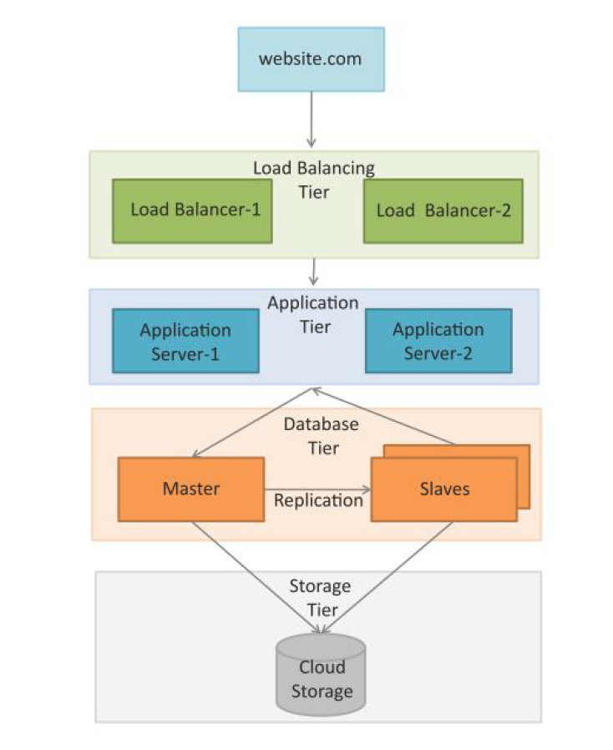
Typical deployment architecture for e-Commerce, Business-to-Business, Banking and Financial apps.
Source: Cloud Computing: A Hands-On Approach by Arshdeep Bahga and Vijay Madisetti
Notes:
This figure shows a Typical deployment architecture for e-Commerce, Business-to-Business, Banking and Financial apps.

Slide 12
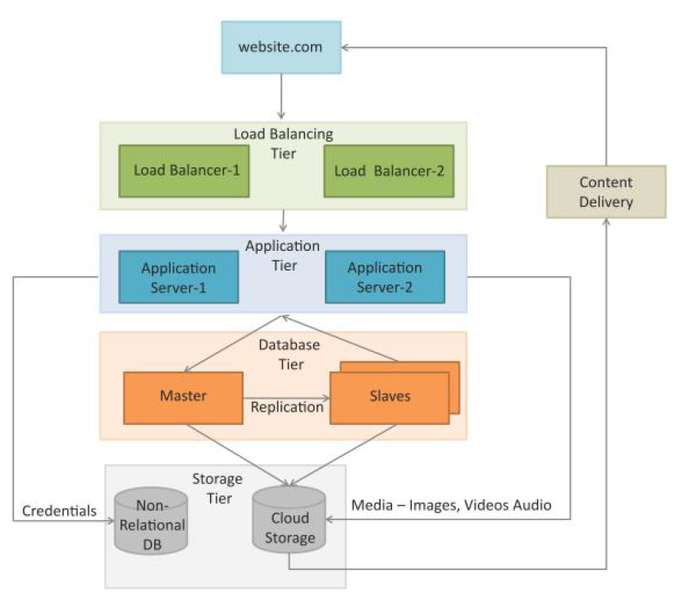
Typical deployment architecture for Content delivery applications as online photo albums, video webcasting, etc.
Source: Cloud Computing: A Hands-On Approach by Arshdeep Bahga and Vijay Madisetti
Notes:
This figure shows a typical deployment architecture for content delivery applications such as online photo albums, video webcasting, etc. Both relational and non-relational data stores are shown in this deployment. A content delivery network (CDN) which consists of a global network of edge locations is used for media delivery. CDN is used to speed up the delivery of static content such as images and videos.

Slide 13
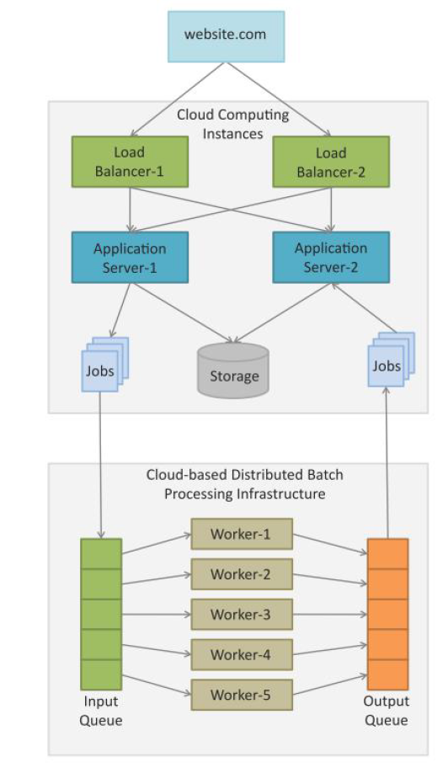
Typical deployment architecture for compute intensive applications such as Data Analytics, Media Transcoding, etc.
Source: Cloud Computing: A Hands-On Approach by Arshdeep Bahga and Vijay Madisetti
Notes:
This figure shows a typical deployment architecture for compute intensive applications such as Data Analytics, Media Transcoding, etc. Comprises of web, application, storage, computing/analytics and database tiers. The analytics tier consists of cloud-based distributed batch processing frameworks such as Hadoop which are suitable for analyzing big data. Data analysis jobs (such as MapReduce) jobs are submitted to the analytics tier from the application servers. The jobs are queued for execution and upon completion the analyzed data is presented from the application servers.

Slide 14
Cloud Application Design Methodologies
Service oriented architecture
Cloud component model
Iaas, Paas and SaaS services for cloud applications
Notes:
.

Slide 15
Cloud Application Design Methodologies
Service oriented architecture
Service
Endpoint
Binding
Interface
Operation
Types
Notes:
Service Oriented Architecture (SOA) is a well established architectural approach for designing and developing applications in the form services that can be shared and reused.
SOA is a collection of discrete software modules or services that form a part of an application and collectively provide the functionality of an application.
SOA services are developed as loosely coupled modules with no hardwired calls embedded in the services.
The services communicate with each other by passing messages.
Services are described using the Web Services Description Language (WSDL).
WSDL is an XML-based web services description language that is used to create service descriptions containing information on the functions performed by a service and the inputs and outputs of the service.

Slide 16
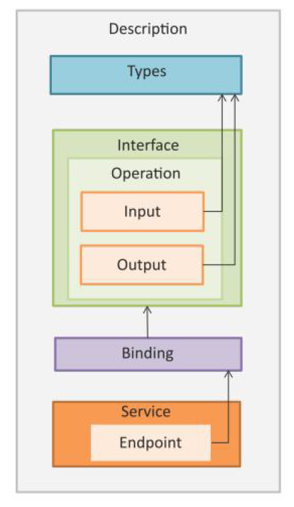
WSDL concepts for representation of web services
Source: Cloud Computing: A Hands-On Approach by Arshdeep Bahga and Vijay Madisetti
Notes:
Service: Service describes a discrete system function that is exposed as a web service.
Endpoint: Endpoint is the address of the web service.
Binding: Binding specifies the interface and transport protocol.
Interface: Interface defines a web service and the operations that can be performed by the service and the input and outputs.
Operation: Operation defines how the message is decoded and the actions that can be performed.
Types: Types describe the data.

Slide 17
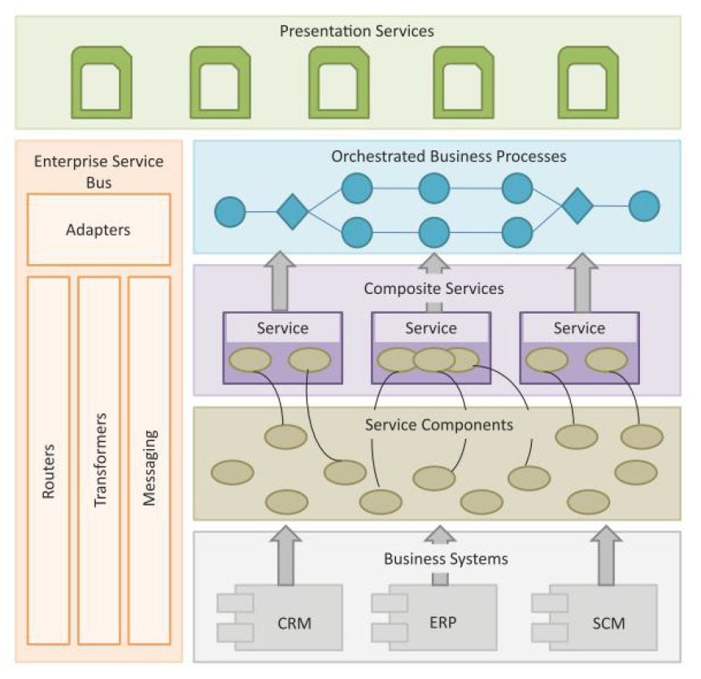
SOA Layers
Business Systems
Service Components
Composite Services
Orchestrated Business Processes
Presentation Services
Enterprise Service Bus
Source: Cloud Computing: A Hands-On Approach by Arshdeep Bahga and Vijay Madisetti
Notes:
• Business Systems: This layer consists of custom built applications and legacy systems such as Enterprise Resource Planning (ERP), Customer Relationship Management (CRM), Supply Chain Management (SCM), etc.
• Service Components: The service components allow the layers above to interact with the business systems. The service components are responsible for realizing the functionality of the services exposed.
• Composite Services: These are coarse-grained services which are composed of two or more service components. Composite services can be used to create enterprise scale components or business-unit specific components.
• Orchestrated Business Processes: Composite services can be orchestrated to create higher level business processes. In this layers the compositions and orchestrations of the composite services are defined to create business processes.
• Presentation Services: This is the topmost layer that includes user interfaces that exposes the services and the orchestrated business processes to the users.
• Enterprise Service Bus: This layer integrates the services through adapters, routing, transformation and messaging mechanisms.

Slide 18
Cloud Application Design Methodologies
Cloud Component Model
Cloud Component Model is an application design methodology that provides a flexible way of creating cloud applications in a rapid, convenient and platform independent manner.
Component Design
Architecture Design
Deployment Design
Notes:
• CCM is an architectural approach for cloud applications that is not tied to any specific programming language or cloud platform.
• Cloud applications designed with CCM approach can have innovative hybrid deployments in which different components of an application can be deployed on cloud infrastructure and platforms of different cloud vendors.
• Applications designed using CCM have better portability and interoperability.
• CCM based applications have better scalability by decoupling application components and providing asynchronous communication mechanisms.

Slide 19
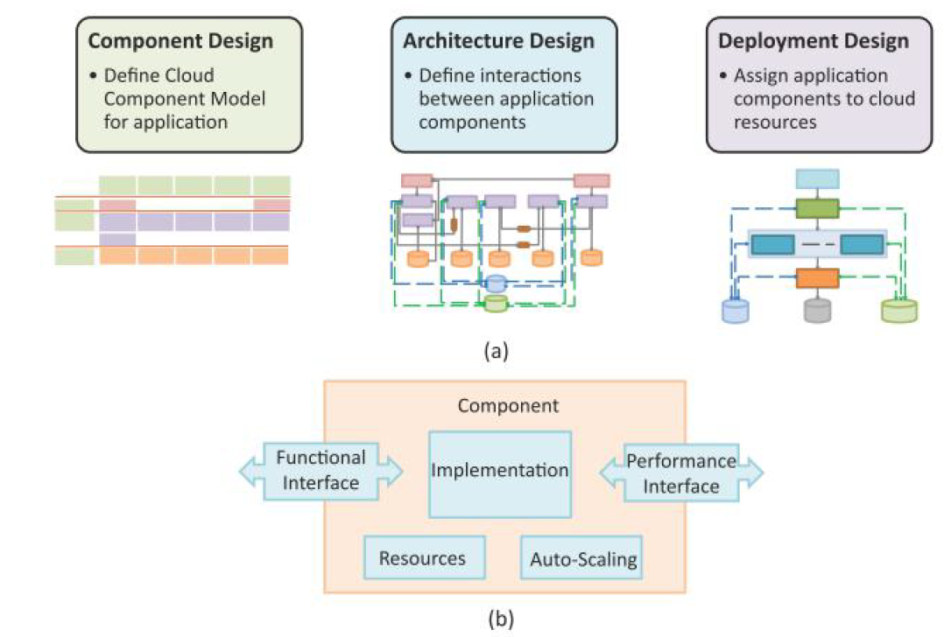
(a) Steps involved in application design using cloud component model methodology, (b) Architecture of a CCM component.
Source: Cloud Computing: A Hands-On Approach by Arshdeep Bahga and Vijay Madisetti
Notes:
In the first step, a cloud component model is created for the application based on comprehensive analysis of the application’s functions and building blocks. Cloud component model allows identifying the building blocks of a cloud application which are classified based on the functions performed and type of cloud resources required. Each building block performs a set of actions to produce the desired outputs for other components. (b) shows the architecture of a CCM component. Each component takes specific inputs, performs a pre-defined set of actions and produces the desired outputs. Components offer their functions as services through a functional interface which can be used by other components. Components report their performance to a performance database through a performance interface. Components have number of resources such as web pages, images, documents, database tables, etc. Auto-scaling performance constraints and conditions can be specified for each component. Component-based approach is applicable to both web-based applications and mobile applications.

Slide 20
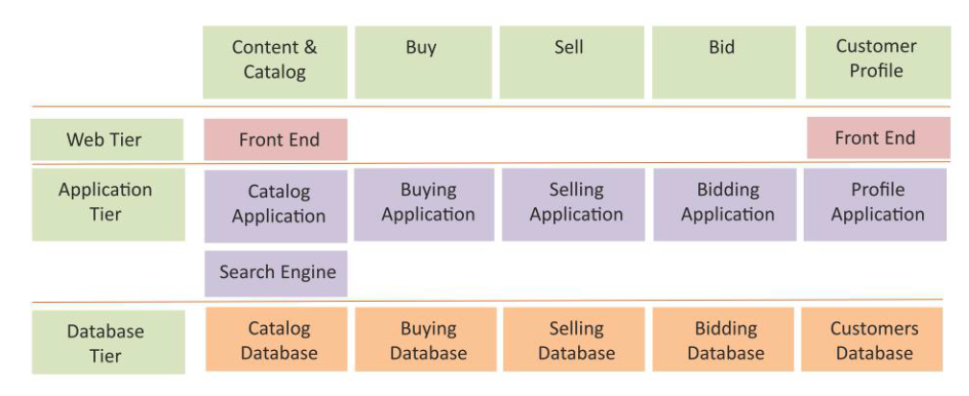
CCM map for an e-Commerce application
Source: Cloud Computing: A Hands-On Approach by Arshdeep Bahga and Vijay Madisetti

Slide 21
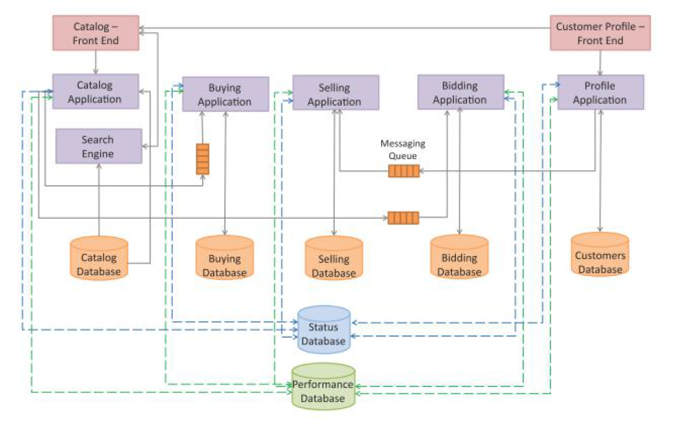
Architecture design of an e-Commerce application
Source: Cloud Computing: A Hands-On Approach by Arshdeep Bahga and Vijay Madisetti
Notes:
In Architecture Design step, interactions between the application components are defined.
CCM components have the following characteristics:
• Loose Coupling: Components in the Cloud Component Model are loosely coupled.
• Asynchronous Communication: By allowing asynchronous communication between components, it is possible to add capacity by adding additional servers when the application load increases. Asynchronous communication is made possible by using messaging queues.
• Stateless Design: Components in the Cloud Component Model are stateless. By storing session state outside of the component (e.g. in a database), stateless component design enables distribution and horizontal scaling.

Slide 22
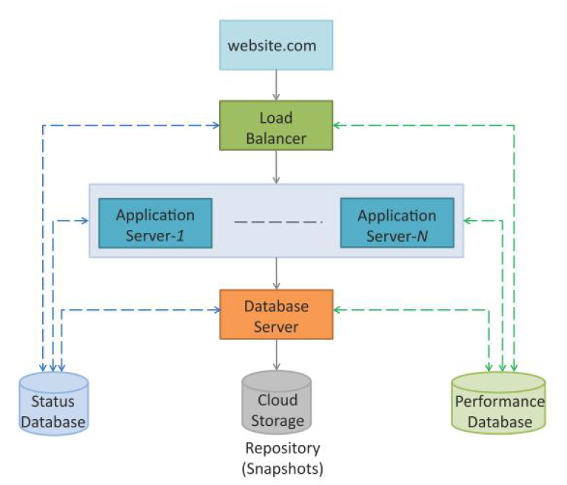
Deployment design of an e-Commerce application
Source: Cloud Computing: A Hands-On Approach by Arshdeep Bahga and Vijay Madisetti
Notes:
• In Deployment Design step, application components are mapped to specific cloud resources such as web servers, application servers, database servers, etc.
• Since the application components are designed to be loosely coupled and stateless with asynchronous communication, components can be deployed independently of each other.
• This approach makes it easy to migrate application components from one cloud to the other.
• With this flexibility in application design and deployment, the application developers can ensure that the applications meet the performance and cost requirements with changing contexts.

Slide 23
Cloud Application Design Methodologies
Iaas, Paas and SaaS services for cloud applications
Amazon, Google, Microsoft, etc. provide various infrastructure (IaaS), platform (PaaS),, and software (SaaS) services that the developers can use for developing and deploying applications in cloud computing enviroments.
Notes:
Cloud service providers make cloud resources available to the users with cloud APIs via a web-based interfaces.

Slide 24
Model View Controller (MVC)
Model
Model manages the data and the behavior of the applications. Model processes events sent by the controller. Model has no information about the views and controllers. Model responds to the requests for information about its state (from the view) and responds to the instructions to change state (from controller).
Cloud component model
Iaas, Paas and SaaS services for cloud applications
Notes:
. Model View Controller (MVC) is a popular software design pattern for web applications.

Slide 25
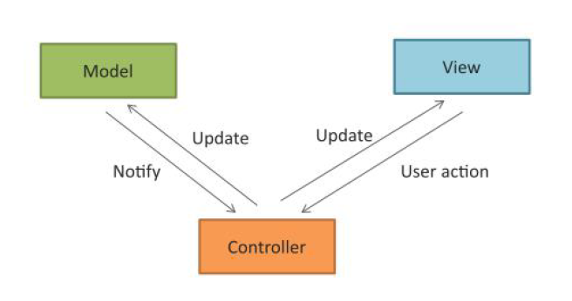
Model View Controller (MVC)
Model
View
Controller
Source: Cloud Computing: A Hands-On Approach by Arshdeep Bahga and Vijay Madisetti
Notes:
. Model View Controller (MVC) is a popular software design pattern for web applications.
MVC separates the application logic, the data, and the user interface. The benefit of using MVC is that improves the maintainability of the application and allows reuse of code. The applications built with MVC architecture can be updated easily due to the separation of the model from the view. In MVC, both the view and controller depend on the model, however, the model does not depend on either. This allows the model to be developed and tested independently. Similarly the separation between the view and the controller is also well defined for web applications.

Slide 26
Model View Controller (MVC)
Model
Model manages the data and the behavior of the applications.
Model processes events sent by the controller.
Model has no information about the views and controllers.
Model responds to the requests for information about its state (from the view) and responds to the instructions to change state (from controller).

Slide 27
Model View Controller (MVC)
View
View prepares the interface which is shown to the user.
Users interact with the application through views.
Views present the information that the model or controller tell the view to present to the user and also handle user requests and sends them to the controller.

Slide 28
Model View Controller (MVC)
Controller
Controller glues the model to the view.
Controller processes user requests and updates the model when the user manipulates the view.
Controller also updates the view when the model changes.

Slide 29
RESTful Web Services
Representational State Transfer (REST) is a set of architectural principles by which you can design web services and web APIs that focus on a system’s resources and how resource states are addressed and transferred.
Client-Server
Stateless
Cacheable
Layered System
Uniform Interface
Code on demand
Notes:
• The REST architectural constraints apply to the components, connectors, and data elements, within a distributed hypermedia system.
• A RESTful web service is a web API implemented using HTTP and REST principles.

Slide 30
Data Storage Approaches
Relational (SQL) Approach
A relational database is database that conforms to the relational model that was popularized by Edgar Codd in 1970.
Non-Relational (No-SQL) Approach
Non-relational databases are popular for applications in which the sale of data involved is massive, the data may not be structured and real-time performance is important as opposed to consistency.
Notes:
A relational database has a collection of relations (or tables). A relation is a set of tuples (or rows). Each relation has a fixed schema that defines the set of attributes (or columns in a table) and the constraints on the attributes.
Unlike relational databases, the non-relational databases do not have a strict schema. The records can be in the form of key-value pairs or documents. Most non-relational databases are classified in terms of the data storage model or type of records that can be stored.

Slide 31
Data Storage Approaches
Relational Databases
Relations
Schema
Tuples
Attributes
Insert/Update/Delete
Primary Key
Notes:
• Relations: A relational database has a collection of relations (or tables). A relation is a set of tuples (or rows).
• Schema: Each relation has a fixed schema that defines the set of attributes (or columns in a table) and the constraints on the attributes.
• Tuples: Each tuple in a relation has the same attributes (columns). The tuples in a relation can have any order and the relation is not sensitive to the ordering of the tuples.
• Attributes: Each attribute has a domain, which is the set of possible values for the attribute.
• Insert/Update/Delete: Relations can be modified using insert, update and delete operations. Every relation has a primary key that uniquely identifies each tuple in the relation.
• Primary Key: An attribute can be made a primary key if it does not have repeated values in different tuples.

Slide 32
Data Storage Approaches
Non-Relational Databases
Key-value store
Document store
Graph store
Object store
The driving force behind the non-relational databases is the need for databases that can achieve high scalability, fault tolerance and availability. These databases can be distributed on a large cluster of machines. Fault tolerance is provided by storing multiple replicas of data on different machines.
Notes:
• Key-value store: Key-value store databases are suited for applications that require storing unstructured data without a fixed schema. Most key-value stores have support for native programming language data types.
• Document store: Document store databases store semi-structured data in the form of documents which are encoded in different standards such as JSON, XML, BSON, YAML, etc.
• Graph store: Graph stores are designed for storing data that has graph structure (nodes and edges). These solutions are suitable for applications that involve graph data such as social networks, transportation systems, etc.
• Object store: Object store solutions are designed for storing data in the form of objects defined in an object-oriented programming language.

